Slide 1
SATHYABAMA INSTITUTE OF SCIENCE AND TECHNOLOGY
LORA BASED HOME AUTOMATION
Guide Name :
Dr. L. Megalan Leo, M.E., Ph.D
Dr. Y. Mohammed Aneesh, B.E.,M.Tech.,Ph.D
Team Members :
RINOSH B - 41130462
RAAJ KENNEDY J - 41130429
RAMESH M - 41130445
RITHIK GOWTHAM K - 41130463

Slide 2
INTRODUCTION
LoRa (Long Range) technology used for wireless communication.
To Control appliances using Arduino and LoRa modules.
Ideal for LoRa-based home automation and long-range remote device control.

Slide 3
ABSTRACT
LoRa IoT project integrates long-range communication technology for IoT-based applications.
Utilizes Arduino Uno and REYAX RYLR996 LoRa modules to build a transmitter-receiver communication system.
Designed to control high-voltage appliances wirelessly over several kilometers.
Implements a feedback mechanism to ensure reliable control and monitoring of devices.
Compact and cost-effective solution instead for IoT-based home automation and industrial control systems.
Project emphasizes low-power operation and scalable future IoT applications.

Slide 4
OBJECTIVES
To design a wireless control system for high-voltage appliances using LoRa.
Ensure reliability with a feedback mechanism for device monitoring.
Develop a scalable, low-power wireless communication solution for diverse use cases.

Slide 5
LITERATURE SURVEY
PROJECT TITLE | KEY FINDINGS | IMPROVEMENTS
LoRa Communication for IoT Applications | Demonstrated Long-range communications in rural areas; focused on enivornmental monitoring. | Limited to data collection ; no control of external devices.
Home Automation using ESP8266 | Showed Feasibility of Wifi-Based Home automation , good for local control | Short range , not suitable for remote outdoor applications.

Slide 6
PROJECT TITLE | KEY FINDINGS | IMPROVEMENTS
Wireless Sensor Network Using LoRa | Effectively implemented Long-Range wireless for sensor network for agricultural monitoring | Did not incorporate real-time control mechanism.
Integration of Lora with Arduino and IoT Frameworks | Proved Reliability of LoRa for IoT projects and Arduino compatibility for low-power devices. | Did not address scalability of feedback systems.

Slide 7
COMPONENTS REQUIRED :
Arduino UNO
REYAX RYLR996 LoRa module
Resistors (4.7kΩ, 10kΩ)
Push buttons
2-channel 5V relay module
230V AC Bulb

Slide 8
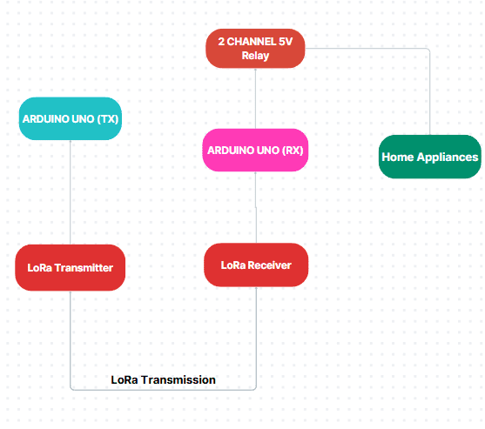
BLOCK DIAGRAM

Slide 9
WORKING MODEL
Push buttons control the state of appliances.
LoRa transmits the commands wirelessly.
Receives signals via LoRa and controls relays.
Feedback system ensures status updates for the transmitter circuit.
Highlight voltage-divider circuits for compatibility between 3.3V and 5V logic.

Slide 10
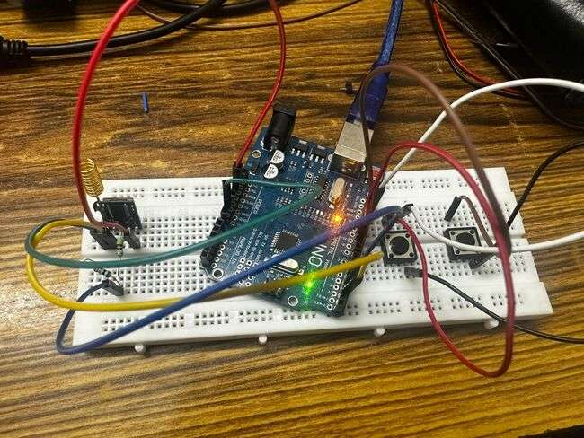
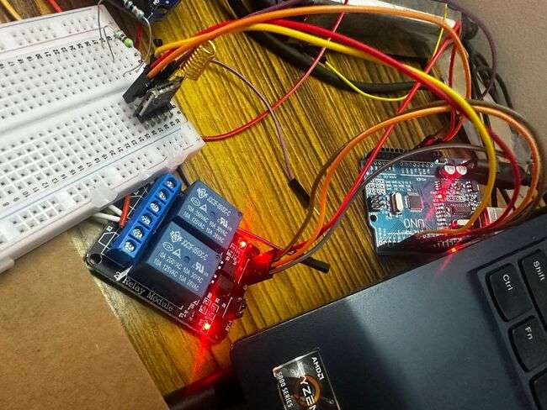
TRANSMITTER CIRCUIT
RECEIVER CIRCUIT

Slide 11
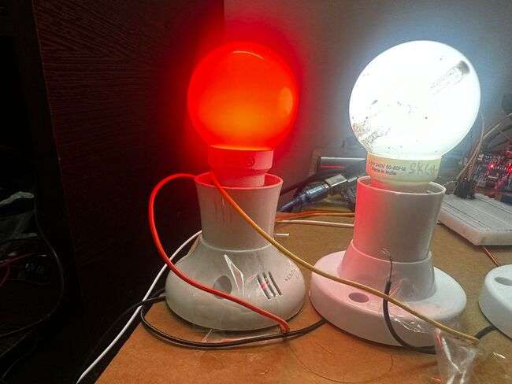
FINAL OUTPUT

Slide 12
FINAL RESULT
Successful wireless control of appliances over several kilometers.
Reliable feedback mechanism for device monitoring.
Scalable for future IoT-based home automation and industrial project

Slide 13
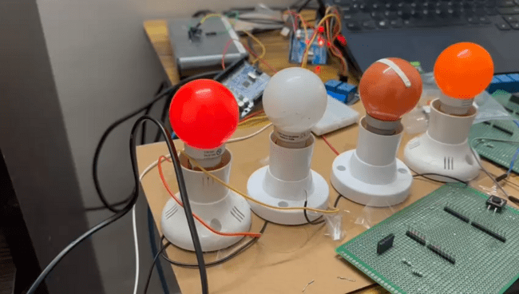
DEMO VIDEO OF THE PROJECT

Slide 14
THANK YOU

